Slide 1
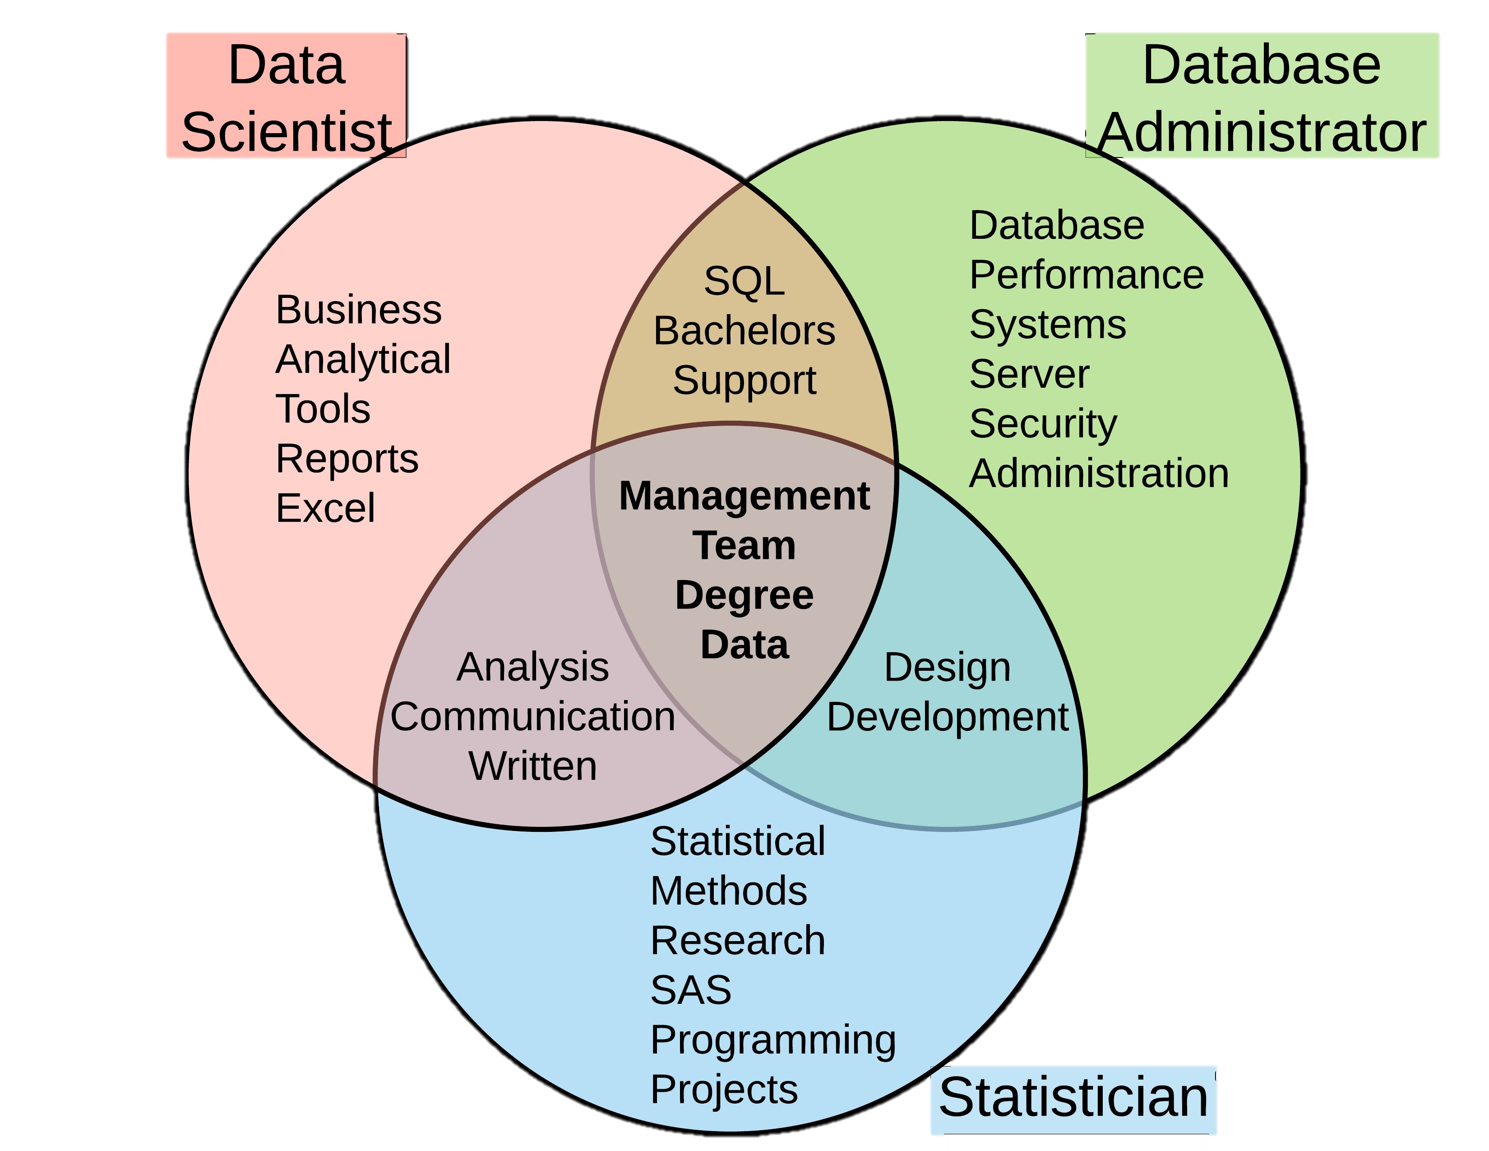
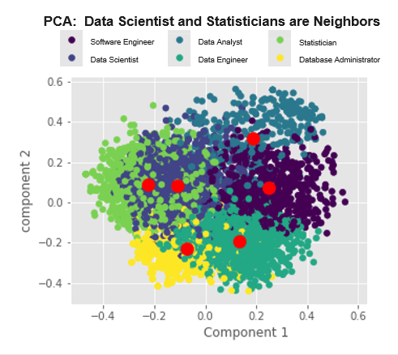
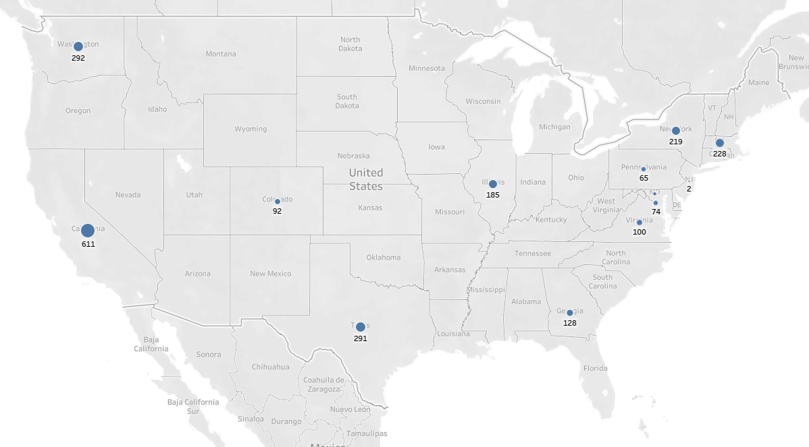
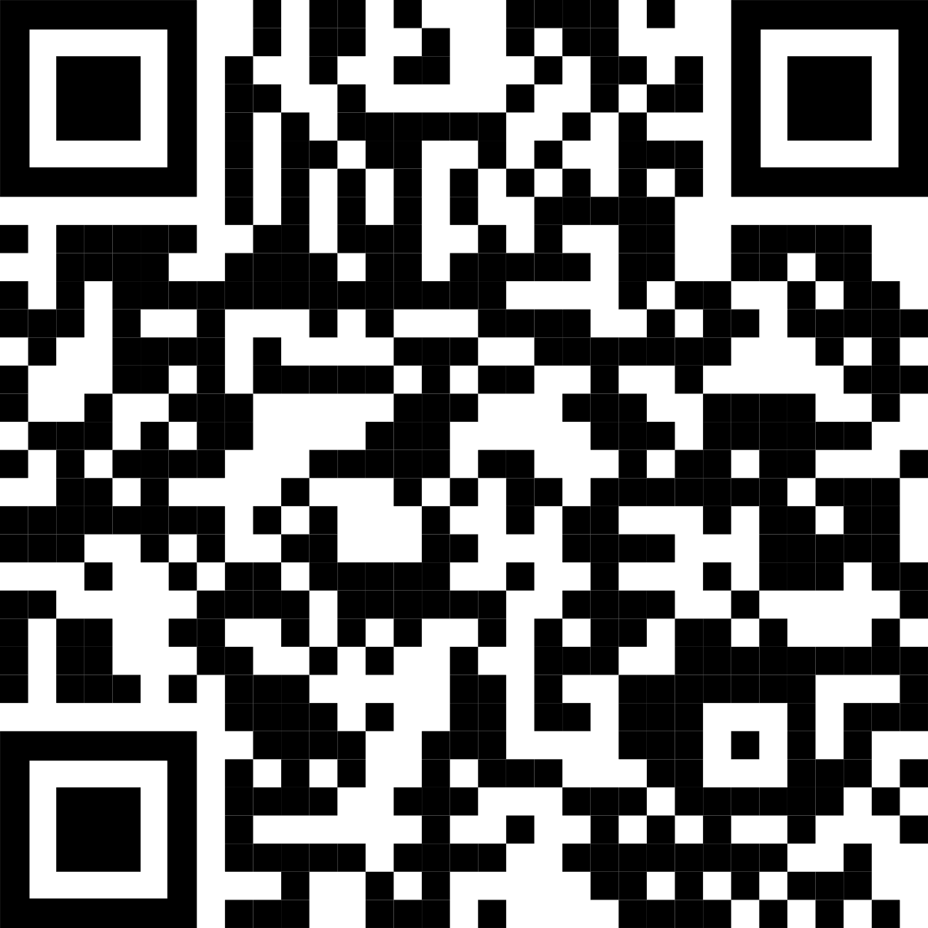



Who or What is a Data Scientist?
Non-Cognitive Predictors of Student Success: A Predictive Validity Comparison Between Domestic and International Students
Non-Cognitive Predictors of Student Success: A Predictive Validity Comparison Between Domestic and International Students
Title: Actual paper long title here
INTRO:
Who cares? Explain why your study matters in the fastest, most brutal wa
METHODS
How did you find this?
Collected [what] from [population]
How you tested it.
Illustrate your methods if you can!
RESULTS
Graph/table with essential results only.
All the other correlations in the ammo bar.
Replace with Results visual (list of characteristics)?
Interact with our data by visiting our Tableau Website
Andy Ho An Nguyen Jodi Pafford
Dr. Robert Slater
Master of Science in Data Science
Southern Methodist University
Dallas, TX 75375, USA
Notes:
Notes:
In Powerpoint, click View > Guides
Keep text within gutter guides.
Author list: Don’t split names onto two lines (e.g., “Jimmy [break] Smith”). If that happens, use a new line, unless you need the space. Bold the first names of anybody who’s presenting in person.
Intro/methods/result: Do not drop below font size 28, but if you have extra space, jack up the font size until the space is full.
Do not use color in the sidebars except in graphs/figures. It’ll pull attention from the center and slow interpretation for passersby.

Slide 2
Notes: 1. Correct fonts won’t load until you open this in PowerPoint (e.g., if you’re previewing this in your browser it’ll look uglier than it actually is). 2. Generate QR codes here: https://www.qrcode-monkey.com/

